Slide 1
California State University, East Bay College of Business and Economics MGMT 6165 Prescriptive Analytics
Simulation Models
Lecture Materials
Dr. Z. Radovilsky
Notes:
1
1

Slide 2
Learning Objectives
Explain principles and applications of simulation
Define advantages and drawbacks of simulation modeling
Identify and explain discrete and continuous distributions typically used in simulation modeling
Develop and utilize simulation models with Excel tools for a variety of business problems
Apply @Risk Excel add-in to build and utilize simulation models
Notes:
2
2

Slide 3
What is Simulation?
The idea behind simulation in business and management is to:
imitate a real‑world situation mathematically
study its properties and operating characteristics
draw conclusions and make action decisions based on the results of simulation.
In simulation, instead of seeking an optimal solution through algorithm or method, we attempt to obtain descriptive information through experimentation
Characteristics of simulation
Simulation is a technique of experimentation to determine the behavior of a system under various conditions
Simulation is usually applied when a decision problem is too complex to be solved by analytical models
Simulation may not precisely represent a real business problem but can merely imitate it
A computer‑based model is usually used to generate descriptive results
An optimal solution routine can be included in the simulation process

Slide 4
Applications of Simulation
Finance
Capital budgeting
Rate of return
Stock price
Portfolio optimization
Marketing
Analysis of market reaction
Analysis of distribution channels
Management
New product introduction
Inventory and order management with variable demand and/or lead time
Analysis of waiting lines
Personnel scheduling and sequencing

Slide 5
Advantages and Drawbacks of Simulation
Advantages
Very flexible, and relatively straightforward
Can be used to analyze large and complex real-world problems for which closed form analytical solutions are not possible
Allows for inclusion of real-world complications, which most other techniques do not permit
Make possible "time compression"
Allows one to ask "what if" type questions
Does not interfere with the real-world system
Allows studying the interactive effect of individual components or variables
Drawbacks
May be very time consuming and expensive
Does not generate (by itself) optimal solutions
Produces a unique model which may not be transferable to another model

Slide 6
Monte Carlo Simulation
The central feature of simulation is the incorporation of random behavior for the variable or variables of interest
For such purposes the Monte Carlo method of simulation may be applied.
The basis of Monte Carlo simulation is experimentation on the chance (or probabilistic) elements through random sampling. The technique breaks down into five simple steps:
Setup probability distribution for an input variable(s)
Build a cumulative probability distribution for each input variable in step 1
Establish interval of random numbers for each variable
Generate random numbers using pseudorandom tables, formulas, computer simulation (the latter is the most common today)
Simulate a series of trials
Formulate a simple plan of obtaining random numbers
Fit these random numbers to the defined probability distribution ranges
Transform the random number into an appropriate outcome of the variable
Repeat the process for each random number

Slide 7
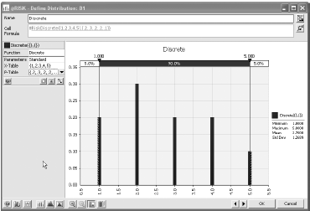
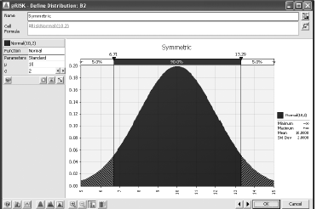
Probability Distributions for Input Variables
The primary difference between the spreadsheet models you have developed so far and simulation models is that at least one of the input variable cells in a simulation model contains random numbers
Each time the spreadsheet recalculates, the random numbers change, and the new random values of the inputs produce new values of the outputs.
This is the essence of simulation—it enables you to see how outputs vary as random inputs change
A probability distribution is discrete if it has a finite number of possible values.
In contrast, a probability distribution is continuous if its possible values are essentially some continuum.

Slide 8
Various Distribution
The uniform distribution is the “flat” It is bounded by a minimum and a maximum, and all values between these two extremes are equally likely.
Any number between minimum and maximum are equally likely to occur
A discrete distribution is useful for many situations, either when the uncertain quantity is not really continuous (the number of children in a family, for example) or as a discrete approximation to a continuous variable
Defined by a set of discrete outcomes and respected probabilities
The normal distribution is the familiar bell-shaped curve that is the hallmark of much of statistical theory
It is useful in simulation modeling as a continuous input distribution
Defined by two parameters: mean and standard deviation
The triangular distribution is somewhat similar to the normal distribution in that its density function rises to some point and then falls, but it is more flexible and intuitive than the normal distribution
Defined by three parameters: minimum, most likely, and maximum values

Slide 9

Random Number Generation: Random Number Table

Slide 10
Random Number Generation: Excel =RAND() RANDBETWEEN() Functions
RAND() generates random numbers between 0 and 1
RANDBETWEEN() generates random numbers between two numbers
Different numbers generated by these functions are probabilistically independent, i.e., a generated random number has no effect on the values of any other random numbers generated in the spreadsheet

Slide 11
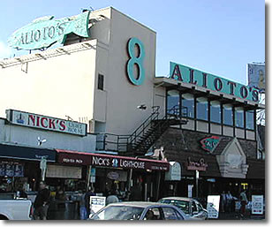
Fisherman’s Wharf: Ordering Crabs
Dining options along Fisherman's Wharf in San Francisco range from sidewalk food stands to traditional Italian/seafood restaurants and a few popular newcomers. One of the most favorite meals in this area is a loaf of sourdough bread from Boudin's and a fresh Dungeness crab from sidewalk vendors, eaten on a dockside bench among the fishing boats. Dungeness crabs, the West Coast's answer to lobster, are in season from November through June. The fresh crabs are usually caught by the local fishermen in early morning and then immediately sold to the local crab stand vendors that cook and sell crabs right in the street. At one of the crab stands, SFCRAB Co., the fishermen sell crabs for $9.9 per pound. The owner of the stand sells crabs for $16 a pound, and the cost of the crab stand (including labor, equipment, rent, water, electricity, etc.) is $3.5 per pound, so that the margin price is $12.5 a pound. If all fresh crabs are not sold on a daily basis, the stand owner can salvage the reminder of crabs to the nearby seafood restaurants, for a price of $2.50 a pound. From the previous years, the stand owner observed the following demand for crabs during a regular day:
On a regular day, the owner of the stand typically orders 240 pounds of crab. Is it the best order quantity for optimizing the average daily profit from selling crabs?
Questions
Construct a spreadsheet simulation model to identify the average profit based on the order quantity of 240 pounds.
Is 240 pounds the optimal order quantity to purchase for the stand?

Slide 12
Simulation Model in Excel

Slide 13
Spreadsheet Simulation with @Risk

Slide 14
New Product Introduction
CompHardware Inc. is going to introduce a new USB drive with 4 terabytes of memory. The data analyst was asked by the company’s general manager to estimate annual profits from this product. However, the company does not have any certain information on what the annual demand for the product will be, and what exact annual fixed cost, variable cost, and selling price will be applied for the new USB product. The analyst gathered some historical data related to the price and cost characteristics of similar products and their demands.
The following tables represent the results of data analyst’s preliminary evaluation:
With these inputs, the data analyst estimated that the potential profit based on the average and most likely results will be $520,000.
Use spreadsheet simulation modeling to identify the expected annual profit for the new USB drive.
Is this annual profit equal or come very close to $520,000?

Slide 15
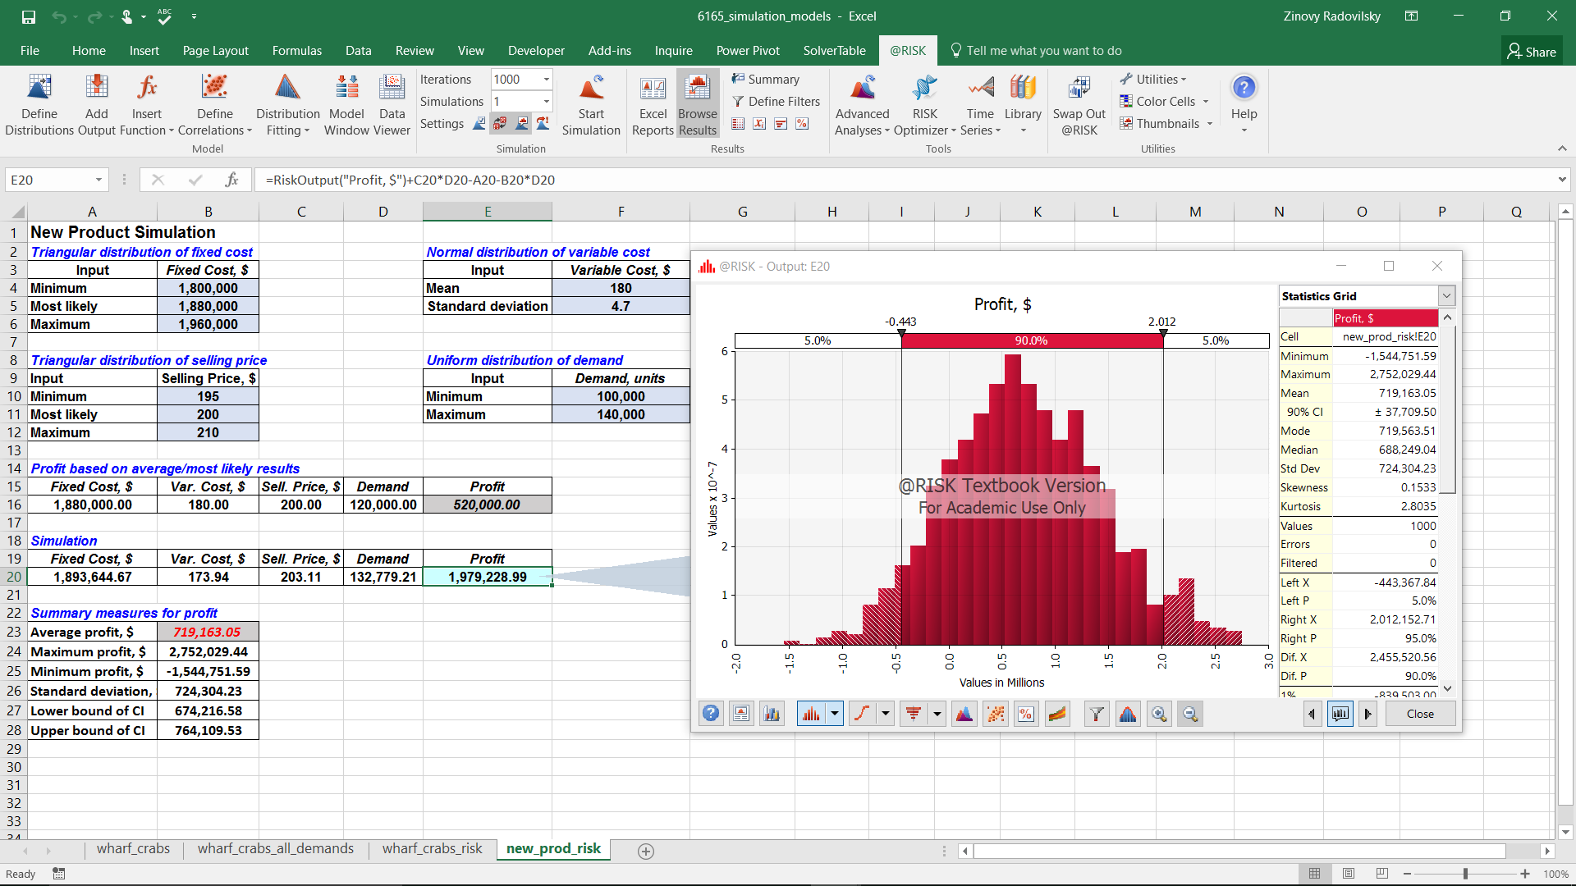
Flowchart of New Product Simulation

